Slide 1
Project 4 - Bank Churn Analysis
Alaina Duquette, Justin Lawrence, and Noah Eiseman

Slide 2
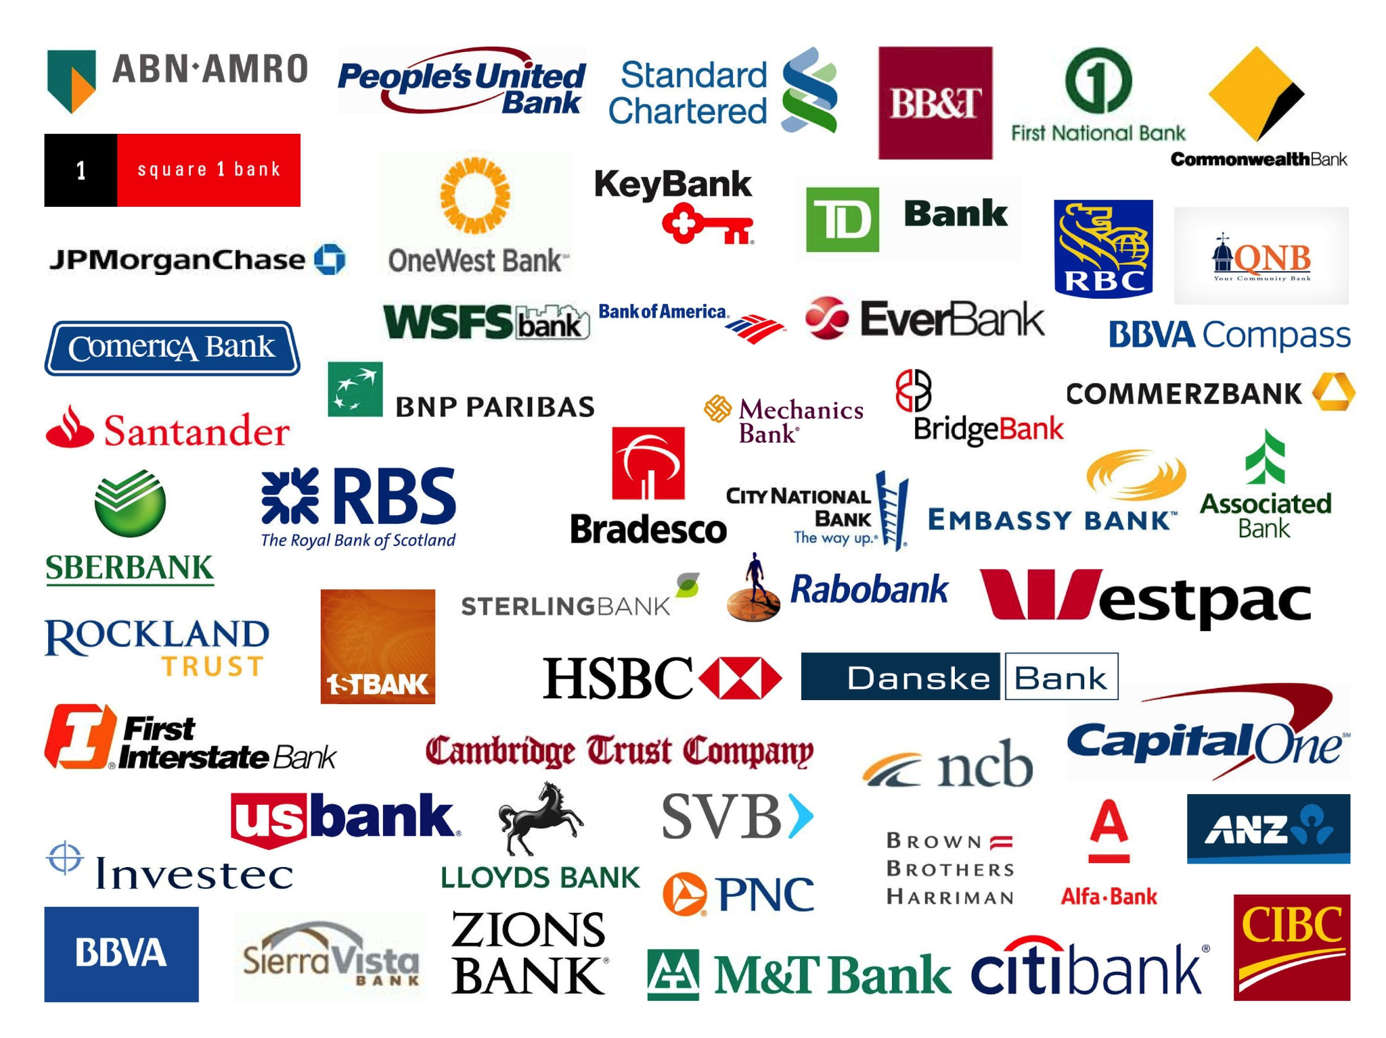
The Challenge
Customer retention is a key area of focus for banks to ensure the longevity of their businesses.
ABC Multinational Corporation is keen on retaining customers and mitigating customer churn.
The bank is looking to use its customer data to predict customer churn.
The findings of this analysis will be used to inform decisions around customer retention strategies.
What are the key factors that predict customer churn and how can we mitigate churn in the future?

Slide 3
Data Overview
The dataset contains over 165,000 customer entries the following features and target:
Credit Score = Used to predict credit behavior.
Country = Demographic information of customers in France, Germany, and Spain.
Gender = Demographic information.
Age = Demographic information.
Tenure = Length of customer patronage at bank.
Balance = Total dollar value of customer balance at bank.
Number of Products = Number of banking products for each customer.
Ownership of Credit Card = Binary variable on whether a customer has a credit card.
Member Activity = Binary variable on whether a customer’s account is active.
Estimated Customer Salary = Dollar value of customer’s salary.
Churn = Binary variable, 1 indicates the customer left, 0 indicates the customer stayed.

Slide 4
Data Analysis
The database showed an imbalance in the number of customers that stayed and customers that left the bank. Around 4 of every 5 records were for customers who did not leave the bank.
To address this imbalance, we used the Random Over Sampling module within our machine learning model.
Using this module helped us increase the accuracy of our model in predicting churned customers.
Number of Customers in Database
Churn = 0 | Churn = 1
130,113 | 34,921

Slide 5
Model Development and Results
The Random Forest Model correctly predicts the outcome in more than 9 out of 10 cases, with an accuracy of 0.94, indicating a high ratio of correctly predicted observations to the total number of observations.
Random Forest Model Results | Precision | Recall | F1-Score | Support
Churn = 0 | 0.98 | 0.90 | 0.94 | 32493
Churn = 1 | 0.91 | 0.98 | 0.94 | 32564
Accuracy |  |  | 0.94 | 65057

Slide 6
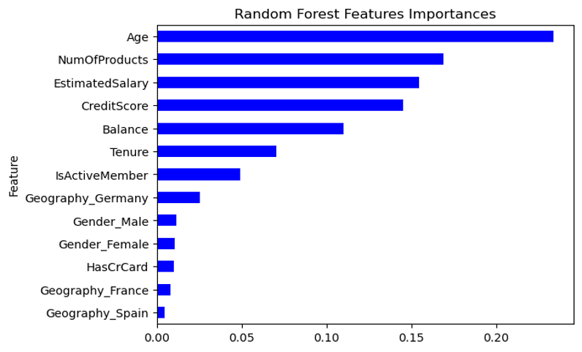
Model Results Informing Strategic Decision Making

Slide 7
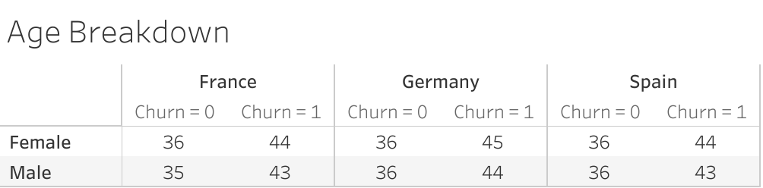
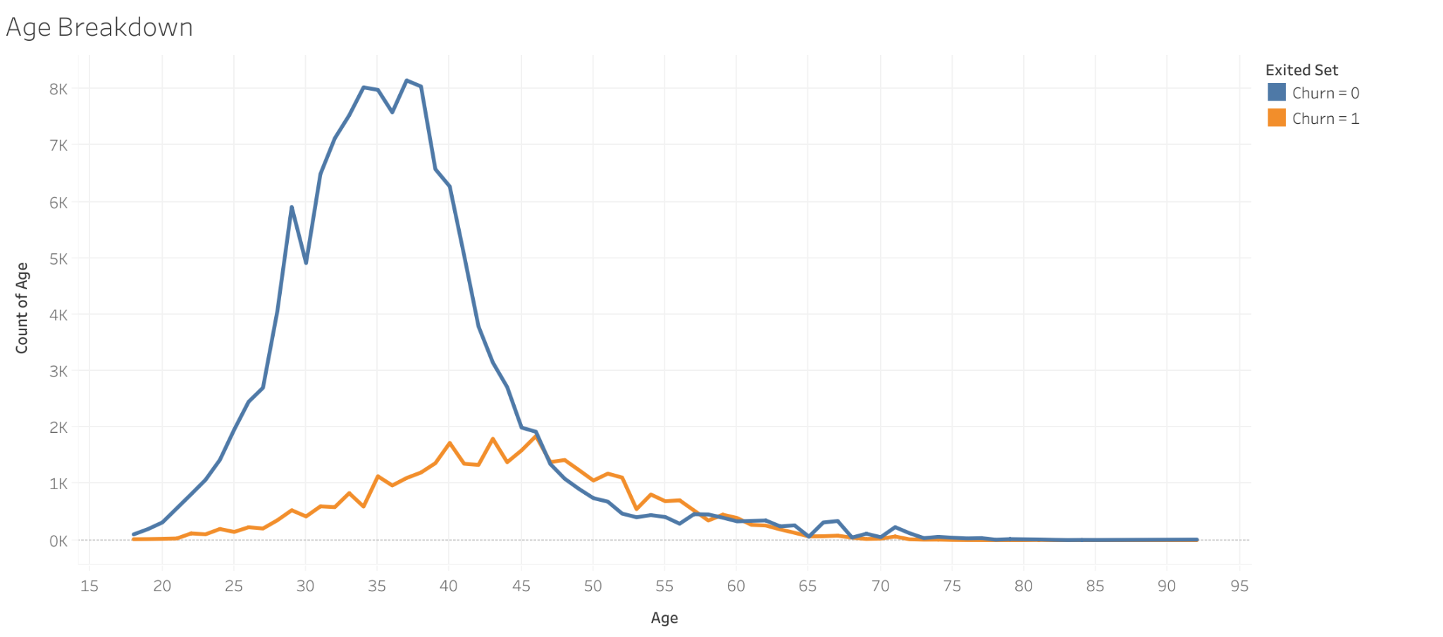
Key Characteristic #1 - Age
Across regional gender indicators, the median age of customers who stayed was 36 while the median age customers who left was 44.
The line graph shows the imbalance of customer types within the dataset but shows key difference where the age values peak.
Both customer types have long tails, indicating that there is still a sizable number of customers over 50.

Slide 8
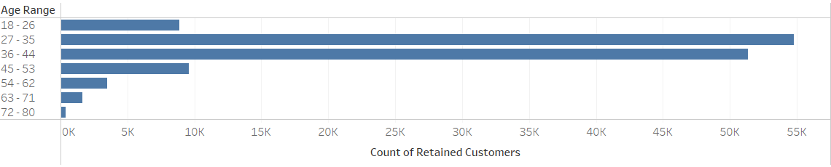
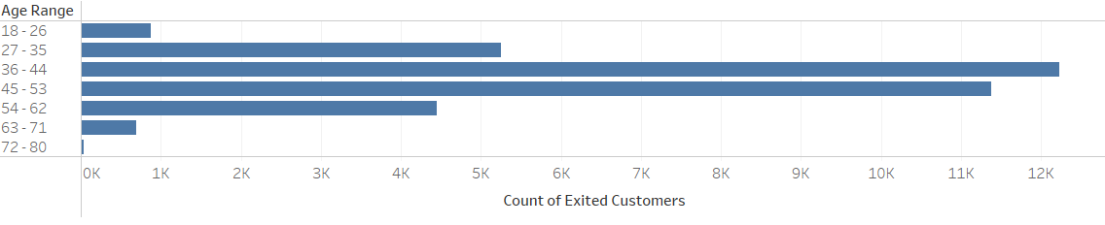
Key Characteristic #1 - Age

Slide 9

Banking Strategies to Attract Young Customers
Young people prefer tech-savvy banking.
Crafting an engaging application that offers easy navigation for customers is crucial.
Integrating an AI interface to provide support for general customer inquiries can enhance the user experience further.
Parental Guidance.
It's common for a significant portion of gen Z customers to have their first financial institution account opened by their parents.
Capital One’s luxe reimagine of banking.
Capital One cafes create a safe space for both relaxing and meeting for financial services.
Has been successful with millennial and gen Z customers

Slide 10
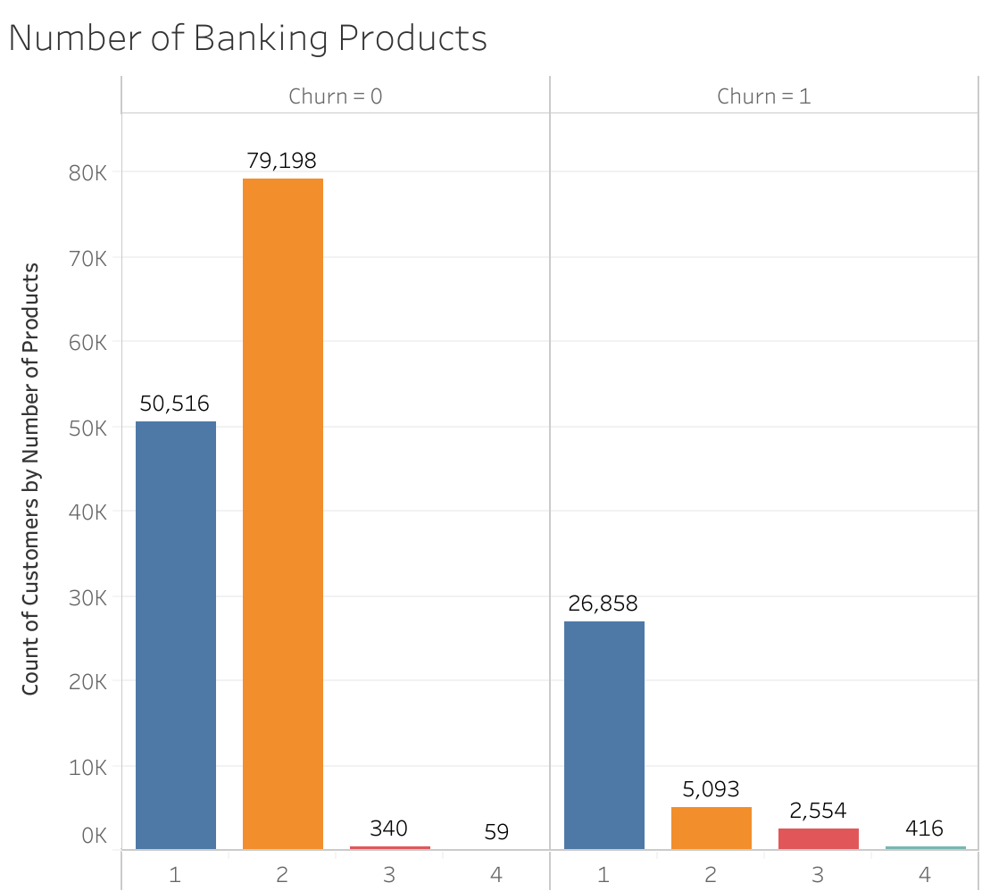
Key Characteristic #2 - Number of Products
Customers who stayed have a higher median number of products than customers who left.
Use of a higher number of products indicates a customers activity at the bank and greater connection to a customers financial goals.
Products like High Interest Savings Accounts, mobile banking apps, and credit cards make banks more attractive to customers and deter customers from choosing competitors.

Slide 11

Banking Strategies to Grow Product Offerings
Market Research and Customer Insights
Gather customer needs, preferences, and pain points.
Has led to the growth of digital banking, direct deposit, and credit card rewards programs.
Cross-Selling and Upselling:
Focused on encouraging existing customers to adopt additional banking products and premium services.
For example, consumer bankers who want to start a business get access to a line of credit or accounting services.
The BILT credit card by Wells Fargo
Pay rent without penalties andand earn points for cash back or travel rewards

Slide 12
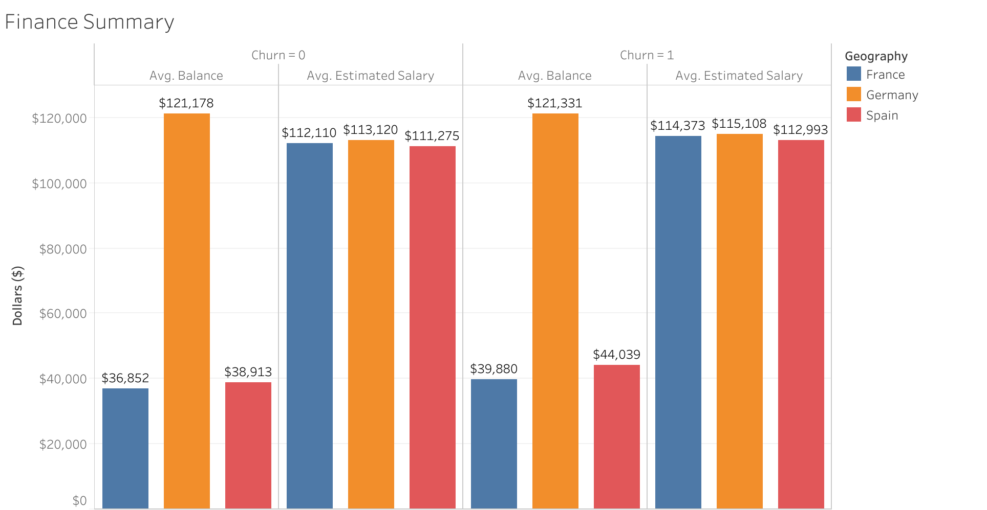
Key Characteristic #3 - Estimated Salary
Customers that stayed tended to have a lower average estimated salary than customers who left.
This variable might be correlated with the Age variable, showing that younger customers tends to have lower estimated income.
For younger customers with financial stability, taking advantage of banking products and savings programs can be beneficial.
But banks tend to be a higher cost for lower income customers due to overdraft fees.

Slide 13
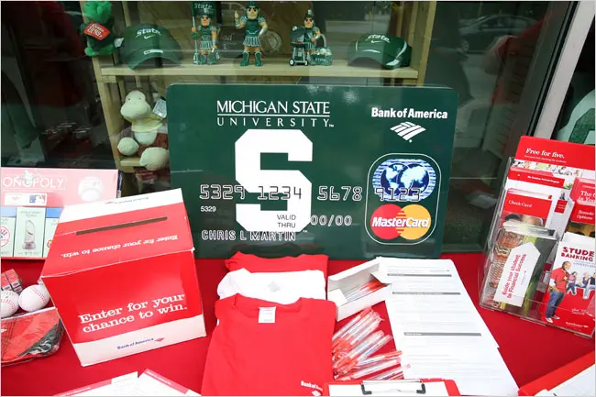
Banking Strategies to Attract Lower Income Customers
Recruitment Starting Early
Enrolling students for debit/credit cards on high school and college campuses.
Higher likelihood of overdraft fees which are a source of income for banks.
Competitive Interest Rates:
Cheap lending options attract prospective home buyers and small business owners
Helps grow customer use of banking products.
PNC Bank x Temple University
Offers special mobile banking, spending, and savings account programs with Temple University Students.
Benefits include no monthly service changes, one automatic refund for overdrafts, and online statements.

Slide 14

Conclusion
Key Takeaways from the Analysis:
Age is the leading factor in the machine learning model. Median age for those that stayed was in the 30s and for those that left was in the 40s.
The age band 27-35 had the highest number of retained customers and the third highest number of churned customers.
Banks should focus on nurturing Gen Z customers to grow and retain the new customer base into the future.

